Slide 1

August 2020 Progress Report

Slide 2
Programme
Yorkshire & Humber Care Record
SRO
John Byrne
Lead
Lee Rickles
RAG status
A-G
Reporting Period
Aug 2020
Key Messages
All ICSs are at different stages of development of the roll out plans for the YHCR. The YHCR programme team are to continue for all of 20/21, this is based upon HSLI funding being provided by HCV. NHS X have briefed ICS on the requirements for COVID 19 phase 3 ICS submissions for shared care records and population health as part of the ICS submission. 251 data processing to allow the data from SoS to be de-id for PHM has been submitted
Key activities & milestones achieved in this reporting period | Key activities & milestones planned for next reporting period
Population Health Support the Connected Bradford team in the use of the data ark. 251 data processing approval has been submitted | Population Health Support the Connected Bradford team in the use of the data ark. 251 data processing proposal is approved and test of the national de-id solution can re-start.
Integrated Care Record A majority of the organisations in on-boarding move to the test stage. Testing has started for TPP non-GP API data transfer. Minimum viable product for 111First has been presented to HCV project group | Integrated Care Record Rotherham FT and Humber FT to go live. A majority of the organisations in on-boarding move to the test stage.
Enduring organisation WYH & SYB have signed off the YHCR value case. Support contracts in place with all systems. Product manager and Service Manager JD have been evaluated | Enduring organisation HCV ICS executive board to approve the YHCR value case. The central programme team is to be continued for all of 20/21. Chief Architecture JD being evaluated. YHCR admin, Product manager and Service Manager recruitment to start in September
Partners NHS Wales proof of concept has been agreed. Creation of a standard MOU and NDA for partners. YHCR to support the COVID 19 phase 3 ICS submissions for shared care records and population health | Partners NHS Wales proof of concept to start.
Items of escalation: None

Slide 3
Population Health

Slide 4
Highlight Report – YHCR PHM Programme Report Date: 10 Aug 2020
Project Summary 1/2
Current Phase:
Support and Deploy
Overall Status:
Project Overview: The Yorkshire and Humber Population Health Management (PHM) solution will enable higher quality reporting and faster, more accurate decision making by developing and integrating a new, region-wide information and analytics service to leverage data emerging from people, services and the internet of things.
Latest Update: The PHM solution continues to develop well during this first six months ‘ early life support’ phase. The Leeds Institute of Data Analytics (LIDA) are using the solution to further analyse the Comprehensive Patient Record (CPR) dataset using R-Studio and Python as preferred tooling. The solution has been successfully tested to utilise flows from System of Systems, using the national De-Id/Re-Id service. Utilising live data flows through System of Systems is progressing. On the advice of NHSX, Humber Teaching Hospitals and NHS Digital we have submitted a section 251 request to CAG. This is being reviewed and aim to have a positive response. The YHPHM Academy will have a virtual team projects showcase and awards event in autumn and this will be extended to be a broader ‘show and tell’ session across the region. The Programme has successfully added new datasets with Connected Bradford on schedule end of May 2020. The users are onboard and using the system for a variety of projects including the HDRUK Better Care Partnership launched in June 2020. The next customer is LTHT and flows are already set up for the DeCOVID project working nationally. The future roadmap for engagement, enhancements and deployment is being developed (for post Oct 2020) and new service management arrangements are bedded in.
Milestones for previous phase | Baseline Date | Expected date | RAG Status | Est. % done | Comments
Additional bulk datasets loaded – cBradford | 31/05/2020 | 31/05/2020 |  | 100 | Complete
De/Re ID using national de-id testing approval – s251 | 31/05/2020 | 31/08/2020 |  | 70 | On track. Functionality proven with live environments and test data. Full use of NHS Digital service required approval of Direction.
Support arrangement finalised – YHCR PHM JIRA portal now live and fully functional | 31/07/2020 | 31/07/2020 |  | 100 | Complete
Transition to long term operational service | 01/10/2010 | 01/10/2020 |  | 80 | Interim arrangements in place and development of long term support model ongoing

Slide 5
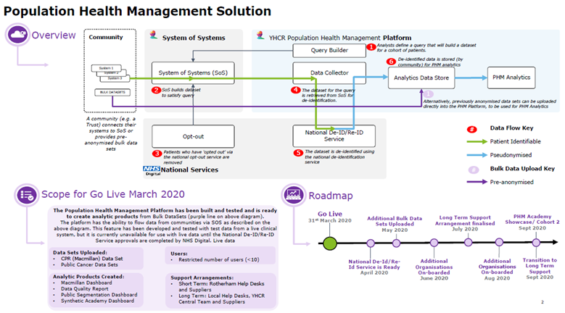
Highlight Report – YHCR PHM Programme Report Date: 10 Aug 2020
Project Summary 2/2
Current Phase:
Road Map Development
Overall Status:

Slide 6
Integrated Care Record

Slide 7
Highlight Report - Yorkshire and Humber Integrated Care Record Programme Report Date: 12th August 2020
Summary Dashboard
Current Phase:
Implementation
Overall Status:
Based on original baseline plan
Pipeline
Top Stories
User interface development project now in flight
HUTH have commenced UAT testing
Transfer of care strategic solution dataset verified at DADA
Engagement Opportunity
EMAS, Mid Yorks, Airedale, TinyApps, Patient Knows Best, Intersystems
WY&H EOL initiative - YAS
WH&H Maternity initiative - ADHFT, BTHFT, CHFT, HDFT, LTHT, MYH
Leveraging Pilots
  Other YAS ToC - Sheffield Children’s Barnsley
  Document transfer - Sheffield THFT
  GP Connect Consumers – Humber, NLAG, LTHT
Clinical focus
Ambulatory Transfer of Care shared to acute care settings
Ambulatory Transfer of Care Strategic Solution
Mental Health Crisis Plans shared to ambulance services
On-boarding
  Harrogate
  Leeds Data Provision
  Blackpear HCV
Up and Coming Release Schedule
12/08 - Dorkie
26/08 - Eurasier
09/09 - Foodle
Connected in test
  Consumers - LTHT
  Providers - NLAG, York, HUTH, Bradford, NYCC, Doncaster, GP Connect
Performance Optimisation, Full Aggregator, Enhance Test Centre
Release Management, Metadata Server, Data Quality Tooling, Security enhancements
Performance Test, GCP Migration, Forensic Analysis Tooling, NEMS integration
Go live phase
  Humber - Mental Health Crisis
  YAS ToC Pilot - Rotherham
Look ahead (Monthly)
Rotherham Consumer Ambulatory ToC
NLAG, HUTH and Blackpear data provision
Leeds and Humber data consumer onboarding
User interface clinical safety requirements
Academy proposal review
Live
  Rotherham – data provision
  YAS ToC Pilot -Leeds
  HELM

Slide 8
Workstream Report –Yorkshire and Humber Integrated Care Record Programme Report Date: 12th August 2020
Technology headlines
Overall Status:
Reported by: Tim Davey
Assured by: Julia Millman
Activities | RAG status | Progress | Planned activities | Blockers
SoS Product development |  | Corgi release live – most significantly including GP Connect (HTML view). Plus enhancements to performance and Test Centre Dorkie release also about to go live – a smaller release including performance enhancements, additional logging, Test Centre enhancements and a variety of small enhancements and fixes to the FHIR Aggregator Work beginning on the “Canvas and Panels” Clinical Portal UI – this is a major development currently in early stages Several sessions to work through requirements of change request for End of Life | Eurasier and Foodle releases planned – these complete the majority of remaining development backlog Ongoing work on Clinical Portal UI BlackPear connectivity adapter deployed, and entering Sandpit testing Ongoing engagement with TPP about access to Community data (e.g. for EoL)
Security |  | On-going work to close off alerts from Google Security Centre License for AppCheck security testing tool received Much work on secure connectivity options for different organisations – e.g. proxy server for BlackPear, VPN for HUTH, plus discussions with NHS Secure Boundary | On-going work with GCP Security Centre and AppCheck to analyse and resolve potential issues Progressing accreditation / assurance frameworks now core infrastructure stabilising e.g. CAF, Cyber Essentials, CSA
National Services |  | GP Connect adaptor (HTML view) implemented Form submitted to use NEMS for alerts on PDS updates Ongoing discussions about alignment with National RBAC approach Engagement begun with NHS Secure Boundary, as a potential mechanism to assist connecting organisations with internet security | Continued work with GP Connect, to add structured datasets Beginning work with NEMS – to get alerts of PDS updates
Transition to GCP |  | Transition activities planned and in progress as part of onboarding | Decommissioning of Rotherham infrastructure scheduled as part of Foodle release (subject to onboarding progress)

Slide 9
Workstream Report –Yorkshire and Humber Integrated Care Record Programme Report Date: 12th August 2020
Testing headlines
Overall Status:
Reported by: Kunle Sadare
Assured by: Julia Millman
Activities | RAG status | Progress | Planned activities | Blockers
Test Strategy/Plan |  | Version 0.2 of Draft test plan completed and distributed for review Review feedback is in progress | Update document after feedback have been received Circulate and present to provider/consumer organisation test community.
HUTH |  | Successfully connected to test harness Initial testing done on patient resource with 3 bugs raised. FHIR data element to help populate test patient data has been sent Testing to commence on other resource w/c 10/08 | Complete sandpit Testing on other FHIR resource Complete Staging testing Complete Clinical safety testing in PROD Produce test exit report
NYCC |  | Test patients demographic details sent FHIR data element to help populate test patient data has been sent | Connect to test harness Help resolve any issue to pass harness test Complete initial sandpit testing Complete Staging testing Complete Clinical safety testing in PROD Produce test exit report
Humber |  | Clinical safety test ongoing | Complete Clinical safety testing in PROD Produce test exit report
Rotherham |  | Initial testing still ongoing | Chase Rotherham for test exit report Complete Clinical safety testing in PROD Produce test exit report
YAS |  | Certificates have been generated | Connect to test harness Help resolve any issue to pass harness test Complete initial sandpit testing Complete Staging testing Complete Clinical safety testing in PROD Produce test exit report
Postman |  | CSR for staging and prod generated in readiness for testing | Install certificates for staging and prod Setup test collections Test environment connectivity

Slide 10
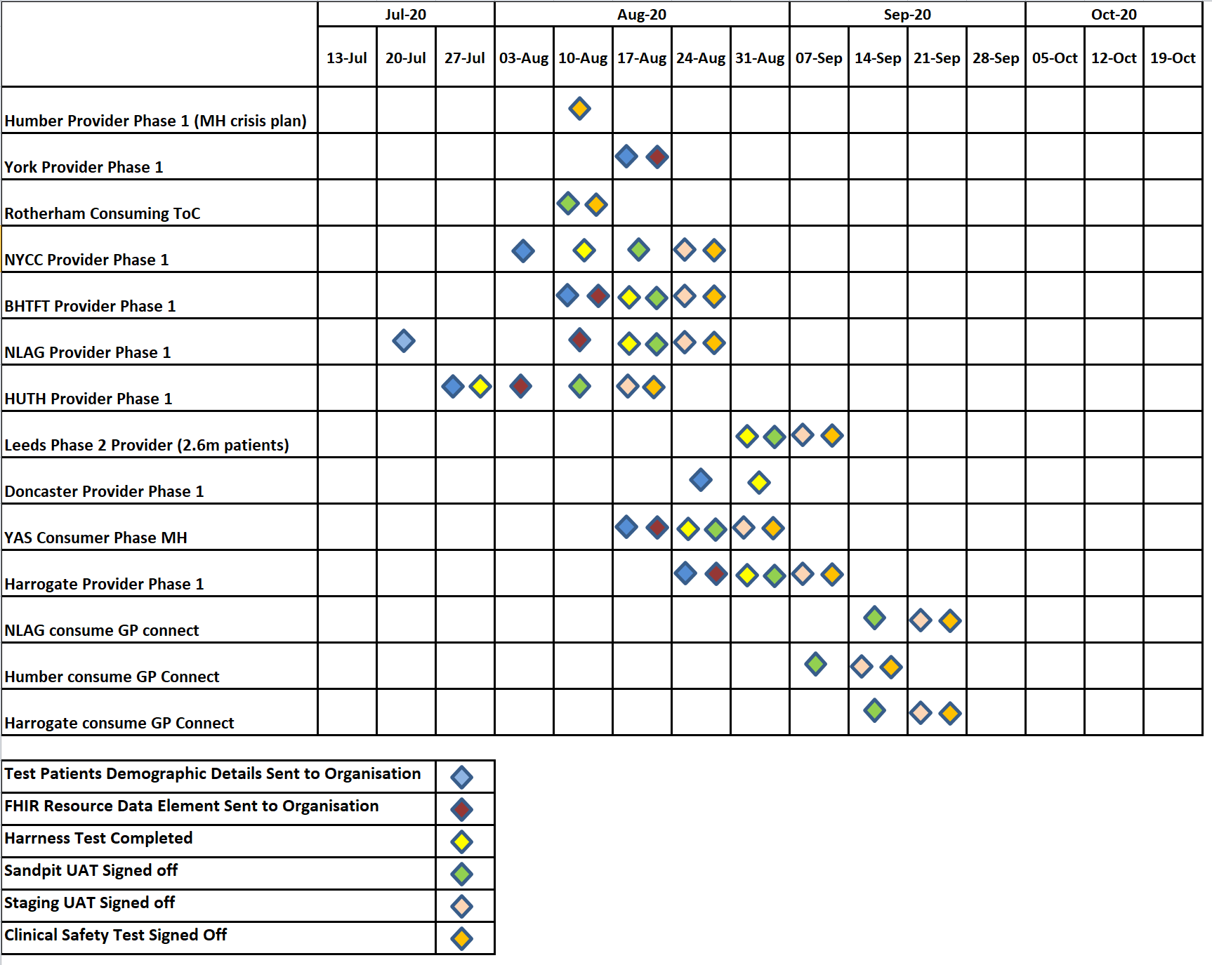
Workstream Report –Yorkshire and Humber Integrated Care Record Programme Report Date: 12th August 2020
Testing Dashboard
Overall Status:
Reported by: Kunle Sadare
Assured by: Julia Millman

Slide 11
Workstream Report –Yorkshire and Humber Integrated Care Record Programme Report Date: 12th August 2020
On-boarding Headlines
Overall Status:
Reported by: Nigel Hodgson
Assured by: Julia Millman
Provider Milestones | Use Case | RAG | Forecast Date | Progress | Planned activities | Blockers
Humber | Mental Health |  | 19/08/20 | 10 patients tested on the Prod Platform Big fixes re-tested still not completed | Further bug fixes confirmed as clinically safe Patient cohort into PIX server complete est. 21/08 CS testing complete Final clinical safety report sign off from CCIO
YAS | Mental Health |  | 04/10/20 | YAS on-boarding began 7th July | Configuration work completed to enter Sandpit for testing YAS testing of MH plan completed Neptune release is scheduled for 4 Oct, testing including CS to be complete by 28 August.
YAS - Leeds | Transfer of Care |  |  | Go live completed 30th June Completed on boarding suite and are now looking to progress consuming regionally | Complete remaining YAS ToC bug fixes
Rotherham | Transfer of Care |  | 19/08/20 | Testing confirmed testing has fixed the Meditech bug | Clinical Safety assured Go Live meeting scheduled 17/08/20
York | Data provision |  | 09/09/20 | Agreement to move to go live without ‘includes’ | Completion of onboarding document to move into the onboarding suite UAT and Clinical safety testing of York dataset Schedule go live meeting scheduled
NLAG | Data provision |  | 16/09/20 | Docker installed onto a clean windows machine | Connect to the test harness following return of the onboarding document UAT and Clinical safety testing IG and TA documents returned
NYCC | Data provision |  | 16/09/20 | Developer completed latest FHIR proxy installation Onboarding document received | Connection to the YHCR test harness UAT and Clinical safety testing IG documents to be returned
Hull | Data provision |  | 09/09/20 | Ensemble work finalised Connected to the test harness and commenced UAT testing | Complete amendments to TA spreadsheet for final approval PIX server work completed CS sign off completed

Slide 12
Workstream Report –Yorkshire and Humber Integrated Care Record Programme Report Date: 12th August 2020
On-boarding Headlines
Overall Status:
Reported by: Nigel Hodgson
Assured by: Julia Millman
Provider Milestones | Use Case | RAG | Forecast Date | Progress | Planned activities | Blockers
Harrogate | Data provision |  | 21/10/20 | Synanetics resourcing quote received | Docker installation complete FHIR dataset work dependant on Synanetics quote IG, TA, CS documentation received | Awaiting ICS funding approval for Synanetics proposal
Bradford | Data provision |  | 16/09/20 | Agreement on VPN connectivity Onboarding data capture sheet received | Connect to test suite TA, CS, IG documents received
Doncaster | Data provision |  | 16/09/20 | Developer commenced FHIR proxy work in test environment Meeting took place to progress plan for Synanetics to support initial connectivity. | FHIR proxy work complete IG and clinical assurance documents received Technical scope review meeting with Synanetics

Slide 13
Workstream Report –Yorkshire and Humber Integrated Care Record Programme Report Date: 12th August 2020
On-boarding Dashboard

Slide 14

Workstream Report –Yorkshire and Humber Integrated Care Record Programme Report Date: 12th August 2020
Other news
Engagement the team are speaking to a number of new partner organisations about the possibility of connecting to the YHCR and are liaising with ICS colleagues to ensure this activity is part of their digital roadmaps.
NHS-X expressed an interest in further collaboration on the YHCR solution.
On-boarding processes have been reviewed and we will continue to discuss this to ensure the YHCR is easy to adopt for future waves
Academy the ICR academy proposal is now been refreshed following initial consultation. The YHCR ICR academy to complement the PHM Academy in supporting colleagues to define, design and deliver regional integrated care.
YHCR operations Requirements to support the tender for the long-term service solution now being considered and permanent roles to support the YHCR operations going forward are now being reviewed by HR colleagues.

Slide 15
Workstream Report –Yorkshire and Humber Integrated Care Record Programme Report Date: 12th August 2020
Risk Dashboard

